Slide 1
Namma Yatri
Trips Analysis
Technical Methodology | Insights | Recommendation
Shayak Majumder
Sharath Chanda Reddy
Satya Ranjan

Slide 2
Agenda
01
Objective & Problem Statement
Slide 03
02
Data Overview & Structure
Slide 04
03
Data Preparation & Cleaning Slide
Slide 05
04
Insights
Slide 06-10
05
Recommendations for Operational Efficiency
Slide 11
Confidential

Slide 3
Objective
&
Problem Statement
Analyse ride data to derive operational and strategic insights.
Focus on demand, revenue, cancellations, and zone-wise trends.
Confidential

Slide 4
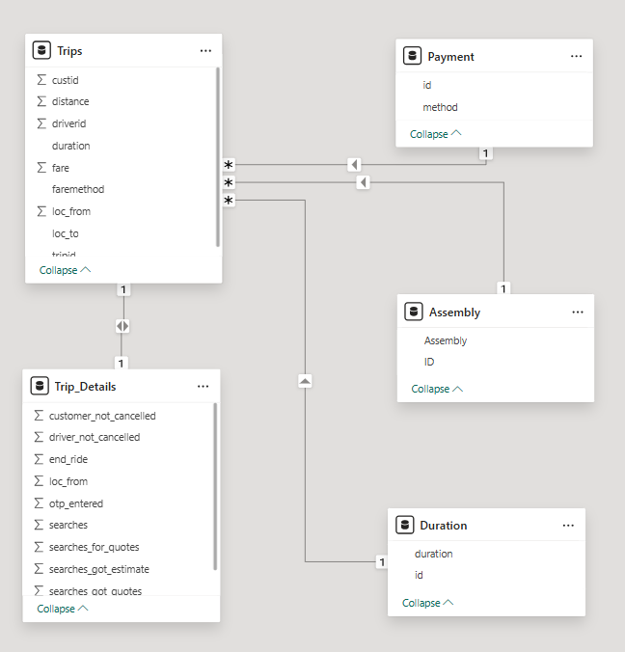
Data Overview & Structure
Five tables: Trips, Trip_Details, Assembly, Duration, Payment.
On Power BI, joined based on common keys like tripid, loc_from, faremethod.
Confidential

Slide 5
Data Preparation & Cleaning
Handled duplicates and nulls
using filters.
Standardised data types: ID columns as text, fares as decimal.
Quick Snapshot
Categorical Variables
From Trips Table:
tripid
driverid
custid
faremethod
loc_from
loc_to
From Trip_Details Table:
tripid
loc_from
From Duration Table:
duration (the original range)
id
From Payment Table:
Method
id
From Assembly Table:
Assembly
ID
Numerical Variables
From Trips Table:
fare (Decimal)
distance (Decimal)
Total Revenue (measure)
From Trip_Details Table:
searches (Whole Number)
searches_got_estimate (Whole Number)
searches _got_quotes (Whole Number)
searches_for_quotes (Whole Number)
customer_not_cancelled (Binary)
driver_not_cancelled (Binary)
otp_entered (Binary)
end_ride (Binary)
From Duration Table:
Duration Midpoint (calculated)
*Details of Calculated Fields
& DAX Measures
in Appendix
Confidential

Slide 6
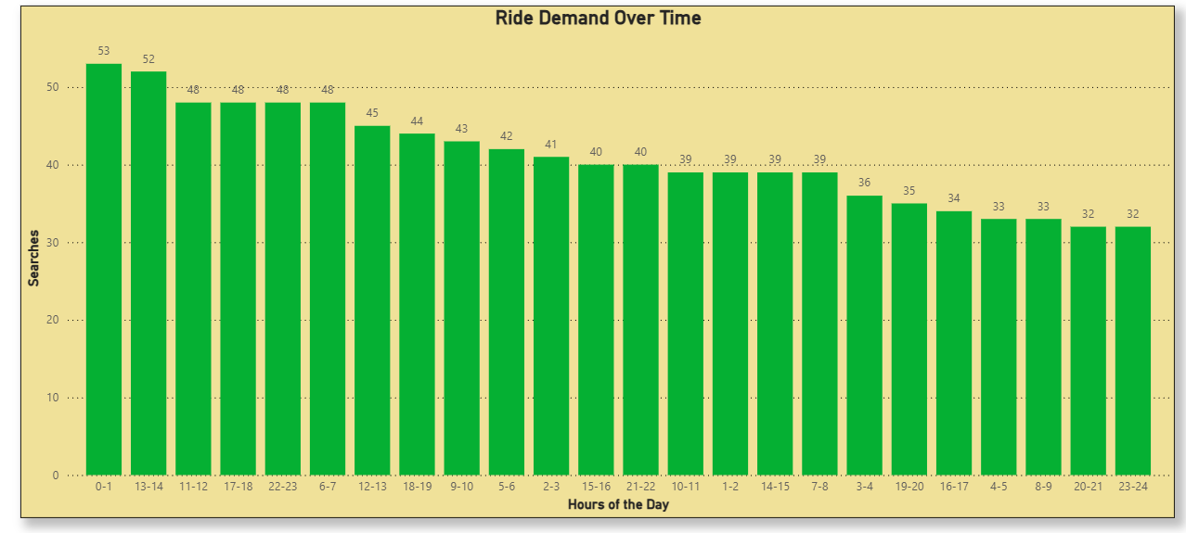
Insights
Ride Demand Over Time
Peak
Lowest
12–1 AM
1–2 PM
11 PM - 12AM
Confidential

Slide 7
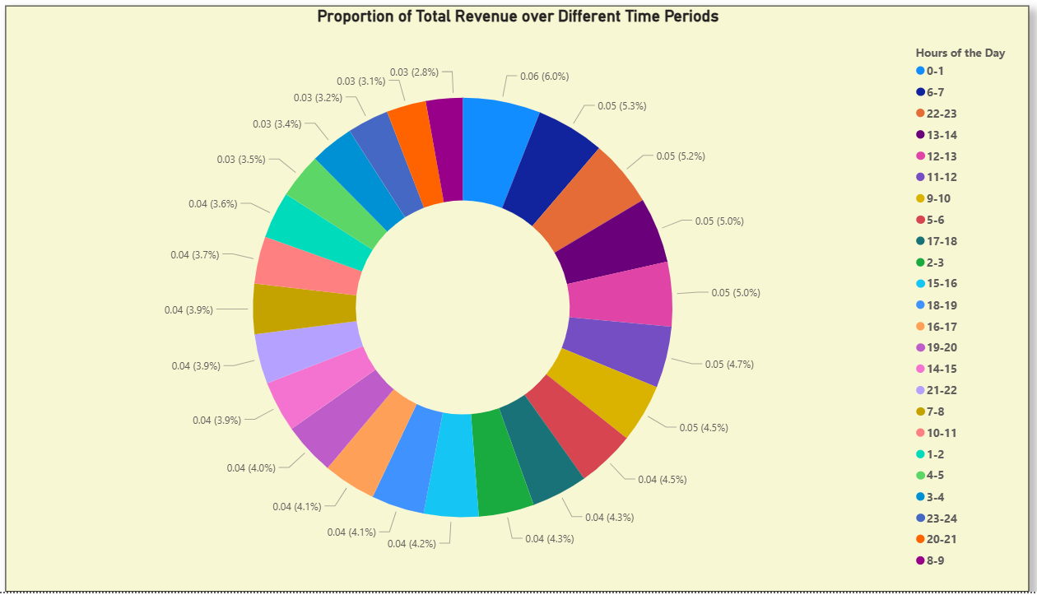
Insights
Revenue Trends by Hour
Highest Revenue
12–1 AM and 6–7 AM show highest revenue.
Confidential

Slide 8
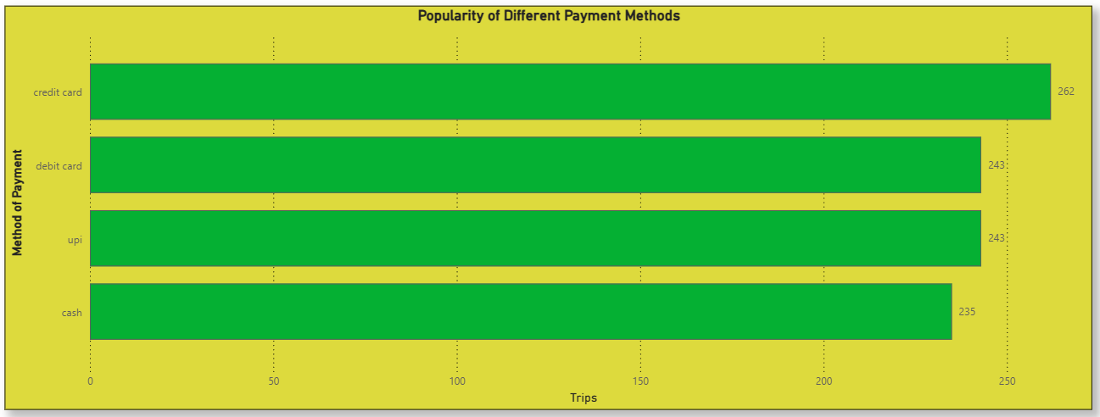
Insights
Payment Method Preferences
Most Used
Credit Cards, followed by UPI & Debit Cards.
Cash least preferred.
Confidential

Slide 9
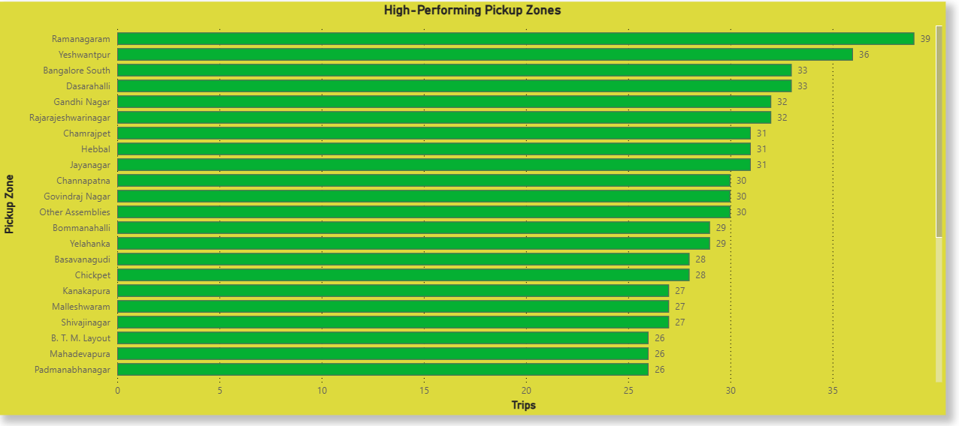
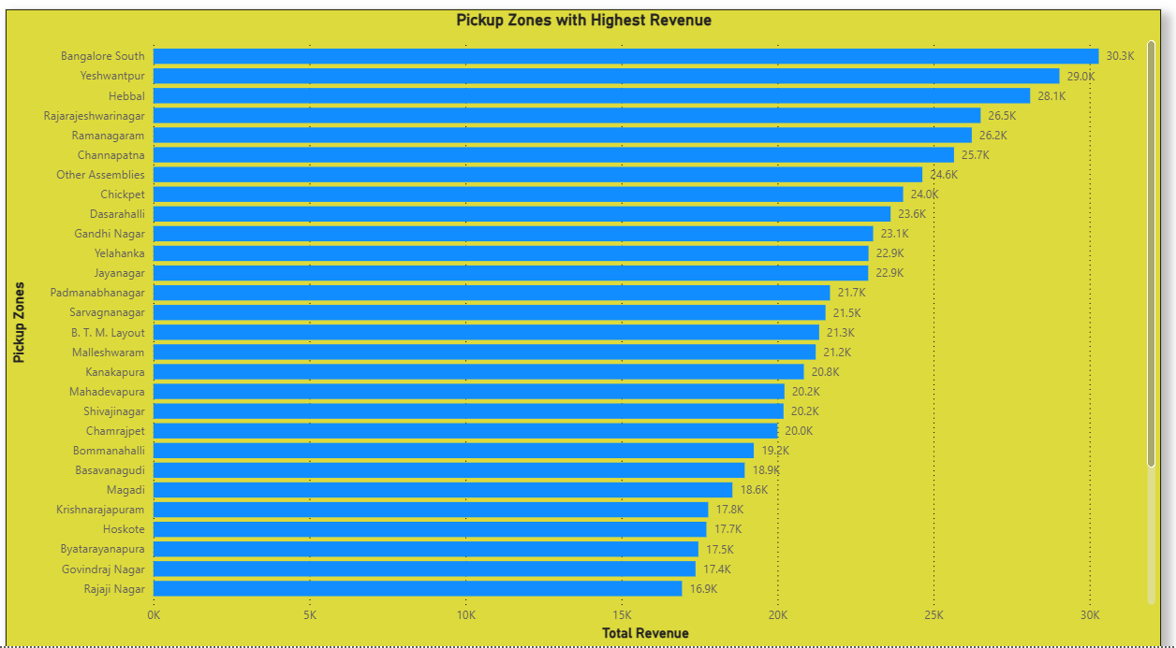
Insights
Zone-Wise Performance
Trips
Ramanagaram leads
Revenue
Bangalore South leads
Confidential

Slide 10
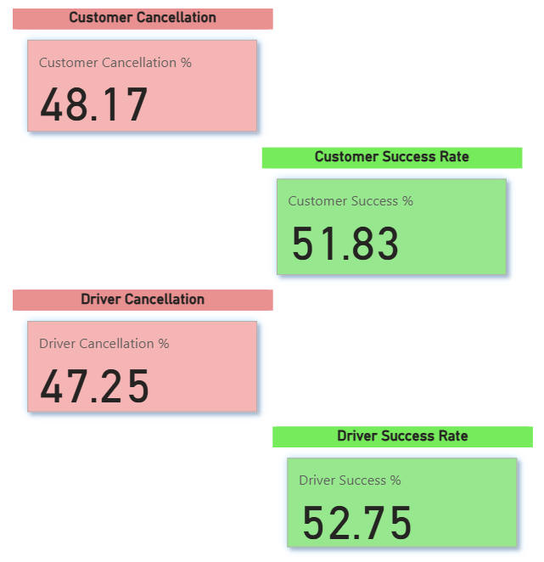
Insights
Cancellations
Driver Vs Customers
Driver & Customer success rates slightly higher than cancellations
Confidential

Slide 11
Recommendations for Operational Efficiency
Allocate More Drivers During High-Demand Hours
Focus on High-Revenue Time Slots
Recommendation: Increase driver availability in the below-mentioned time slots to reduce wait time and cancellations.
Reason: 12 AM–1 AM (0-1) and 1 PM–2 PM (13-14) are peak search hours.
Recommendation: Offer surge bonuses and optimise driver deployment during below-mentioned windows.
Reason: 12 AM–1 AM, 6–7 AM, and 10–11 PM drive the most revenue.
Reduce Cancellations via Root Cause Analysis
Use Zone-Specific Revenue Analysis
Recommendation: Identify frequent causes and address them through app improvements or incentives for completed rides.
Reason: There is a noticeable % of both driver and customer cancellations.
Recommendation: Dynamically adjust driver distribution based on historical zone-wise profitability.
Aid: The Revenue by Zone and Duration chart with slicer allows filtering revenue by zone and time (2.10 on .pbix).
Confidential

Slide 12
Thank you!
Confidential

Slide 13
Appendix
Calculated Fields & Dax Measures
Total Revenue:
Total Revenue = SUM(Trips[fare])
Proportion of Revenue:
Proportion of Revenue =
DIVIDE(
SUM(Trips[fare]),
CALCULATE(SUM(Trips[fare]), ALL(Duration)),
0
)
Competed Trips:
Completed Trips =
CALCULATE(
COUNTROWS(Trip_Details),
Trip_Details[end_ride] = 1
)
% Completion After Quote Search:
% Completion After Quote Search =
DIVIDE(
CALCULATE(
COUNTROWS(Trip_Details),
Trip_Details[searches_for_quotes] = 1,
Trip_Details[end_ride] = 1
),
CALCULATE(
COUNTROWS(Trip_Details),
Trip_Details[searches_for_quotes] = 1
)
)
Revenue by Zone and Duration:
Revenue by Zone and Duration =
CALCULATE(
SUM(Trips[fare]),
FILTER(
ALL(Assembly[Assembly]),
Assembly[Assembly] IN VALUES('Zone Filter'[Assembly])
)
)
Confidential

Slide 14
Appendix (contd.)
Calculated Fields & Dax Measures
Driver Cancellation %, Driver Success %, Customer Cancellation %, and Customer Success %:
Driver Cancellation % =
DIVIDE(
CALCULATE(COUNTROWS(Trip_Details), Trip_Details[driver_not_cancelled] = 0),
COUNTROWS(Trip_Details)
) * 100
Driver Success % =
DIVIDE(
CALCULATE(COUNTROWS(Trip_Details), Trip_Details[driver_not_cancelled] = 1),
COUNTROWS(Trip_Details)
) * 100
Customer Cancellation % =
DIVIDE(
CALCULATE(COUNTROWS(Trip_Details), Trip_Details[customer_not_cancelled] = 0),
COUNTROWS(Trip_Details)
) * 100
Customer Success % =
DIVIDE(
CALCULATE(COUNTROWS(Trip_Details), Trip_Details[customer_not_cancelled] = 1),
COUNTROWS(Trip_Details)
) * 100
Confidential

